Slide 1
Eastern Shore Minor Hockey Association
Annual General Meeting
June 1, 2026, 7pm, ESRC
2025/2026-year end reports
Questions and Answers
Conclude 2025-2026 season
Election of vacant positions for 2026-2027 executive

Slide 2
CURRENT EXECUTIVE
President | VACANT
Vice President | Adam Jennex
Ice Scheduler | Ashley Halloran
Treasurer | Jayne Breton
Registrar | Janet Boutilier
Coaching Coordinator | Whitney Halloran
Secretary | Julie Wagner
Risk Manager | Laura Rockwood
League Coordinator | Hugues Mackay
Development Coordinator | Becky Warner
Equity, Diversity & Inclusion Coordinator | Tanya Bezanson
Equipment Manager | Joel Stevens
Budget Coordinator | Sheryl Delaney
U7 Coordinator | Victoria Meldrum-Young
U9 Coordinator | VACANT
U11 Coordinator | Laura Rockwood
U13 Coordinator | Gillian Florence
U15 Coordintor | Chelsea Burgess
U18 Coordinator | Tanya Bezanson
U23 Coordinator | Adam Jennex
Goalie Coordinator | Janet Boutilier
Referee in Chief | Pete Lenihan
5050 Coorodinator | Debbie Walsh
House Tournament Coordinator | Kelly Greenland
Jamboree Coorinator | Victoria Meldrum-Young

Slide 3
Eastern Shore Minor Hockey Association Executive Summary
In 2025-2026 season the board had 21 elected/appointed positions which were filled by only 16 individuals
  Executive members that represent each age level
  U7 – 3 (Becky, Julie, Victoria)
  U9 – 1 (Julie)
  U11 – 4 (Gillian, Hugues, Jayne, Laura)
  U13 – 8 (Adam, Becky, Chelsea, Gillian, Hugues, Joel, Julie, Tanya)
  U15 – 5 (Adam, Ashley, Chelsea, Jayne, Sheryl)
  U18 – 2 (Laura, Tanya)
  * Most of the executive also fill roles at the individual team level (coaches, managers, trainers, treasurers)
  3 positions held by non-parents

Slide 4
Eastern Shore Minor Hockey Association Executive Summary
Executive met in-person or virtually over 12 times throughout the season
  Meetings averaged 2 hours in length, with >80% attendance
Many positions are due for election, including;
  President
  Secretary
  Registrar
  Budget Coordinator
  Development Coordinator
  Equipment Manager
  Risk Manager

Slide 5
Presidents Report - vacant
On behalf of Eastern Shore Minor Hockey, I want to thank each volunteer and family that has supported their player and the association through a fantastic season. Without your support, we wouldn't be able to provide hockey to hundreds of our Youth every season.
Our presidency remained vacant for this season. Adam Jennex VP, acted in the role when required.
We recognized four outstanding individuals this season with the following awards:
JOSH CURWIN- awarded the Peter Lenihan Official of the Year, Recognizing an individual for their commitment, positive impact on hockey, and outstanding contributions to officiating
EMILY HUNTER - awarded the Gina Dunn Volunteer of the Year -Recognizing an individual for their selflessness, years of volunteer service, and positive impact on the game, association, and community.
JOEY LEY - awarded the Paul McKenna Volunteer Coach of the Year -Recognizing an individual for their passion and dedication to help inspire others to be great people, athletes, and teammates.
WESTIN JENNEX - awarded the Andrew Gordon Player of the Year - Awarded to a player for their game changing excellence, attitude, respect, dedication, and seasons outstanding performance

Slide 6
Vice-President report
- Adam Jennex
ESMH received 24 suspensions from HNS during the season
  1 spectator suspension
  3 coach suspensions
  19 player suspensions (9 of these were U23)
  80 total games suspended + one indefinite
Previous season was 8 (5 player and 3 coach)
Discipline committee was called in response to one incident

Slide 7
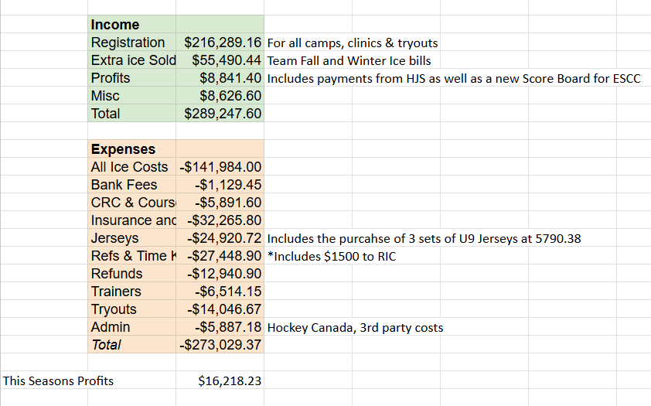
FINANCIALS
Treasurer Report – Jayne Breton

Slide 8
FINANCIALS
Treasurer Report – Jayne Breton
Main Account Balance as of May 31 2026 | 35605.09
Funds in case of team failure | 10 000
Jersey Fund | -11670
New to Hockey Account | 6612.35
Profits | 8841.40
Profits from this Season | 16218.23

Slide 9
FINANCIALS
50/50 – Debbie Walsh
We had another very successful season with our 50/50 fundraiser through Rafflebox. Between November and February, we held four monthly draws and sold more than 1,800 tickets. Participation was outstanding, with over 220 players taking part in sales, along with the Eastern Shore Thunder team.
Our largest jackpot was awarded during the first monthly draw, with the winner taking home more than $13,000. The remaining three draws were also very successful, with prizes ranging from just over $2,300 to nearly $3,000. Even more exciting, all four winners were residents of the Eastern Shore community.
One of the biggest highlights of this fundraiser was the direct impact on our players and families. Through ticket sales, players raised nearly $17,000 toward registration fees and fundraising goals. Many families chose to carry their proceeds forward toward the 2026–2027 season, while others used their earnings to support their team fundraising budgets. Our top individual fundraiser earned nearly $500 toward next season’s registration.
This success would not have been possible without the efforts of our players, families, volunteers, and everyone in the community who supported the fundraiser throughout the season. Thank you to everyone who helped make this year’s 50/50 program such a success.

Slide 10
House Tournament
Teams and Games:
March 23-29 - U11 and U13
March 30-April 5 - U15 and U18
80 Games in total (20 at each age level - U11, U13, U15, U18)
32 Total teams
U15 proved the most difficult level to get teams
Many travel teams this year - 2 at U13, 1 at U15 and 4 at U18.
Home teams at U11 took Silver (Black Team) and Bronze (Gold Team) in the 'A' pool
Home team at U13 took 4th place in the 'B' pool
Home team at U15 took the Gold in the 'B' pool
No home team at U18 - Cole Harbour Red took Gold in 'A' pool and Cape Breton County Islanders took Gold in the 'B' Pool
Financials:
Registration Fee was $1150 per team (28 teams paid, 4 home teams with free registration)
Sponsorships - approximately $6500
Apparel - brought in just under $1000
Pete'Za fundraiser was a HUGE help in raising funds this year - brought in over $1800
Tournament Raffles & 50/50 and Donations brought in almost $4500
All expenses have been paid and the account is sitting at just over $7600

Slide 11
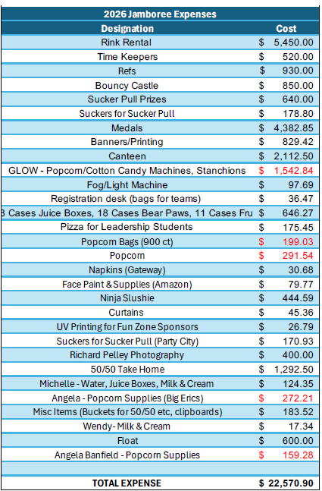
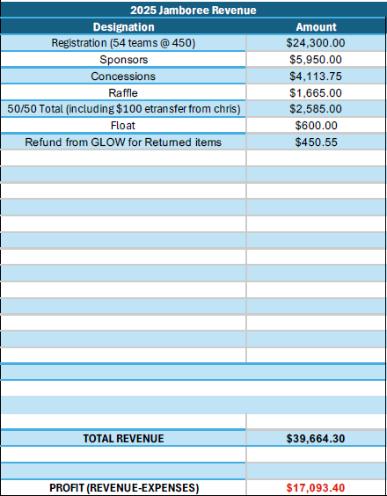
FINANCIALS
U7 Jamboree – Victoria Meldrum-Young

Slide 12
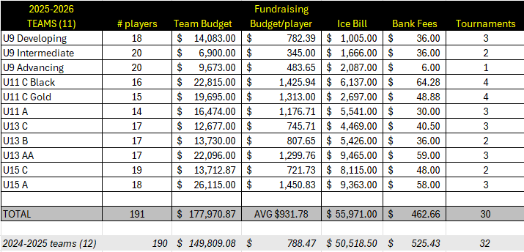
Budget Coordinator Report
- Sheryl Delaney
ESMH modified hotel fundraising rules this season to allow each player to fundraise for hotel expenses

Slide 13
Registrar Report – Participants
- Janet Boutilier
GROUP | # PARTICIPANTS | # TEAMS | CHANGE 2024/25
U7 | 95 | 3 | +11
U9 | 60 | 3 | +1
U11 | 46 | 3 | -3
U13 | 52 | 3 | +13
U15 | 37 | 2 | +9
U18 | 19 | 0 | N/A
U23 | 16 | 1 | N/A
325 PARTICIPANTS REGISTERED FOR THE SEASON BUT WE ONLY HAD 305 ACTIVE PLAYERS FOR THE SEASON
14 MORE PARTICIPANTS THAN 2024-2025 SEASON
20 MORE PARTICIPANTS THAN 2023-2024 SEASON
Not enough players/goalie to offer a U18team for the season

Slide 14
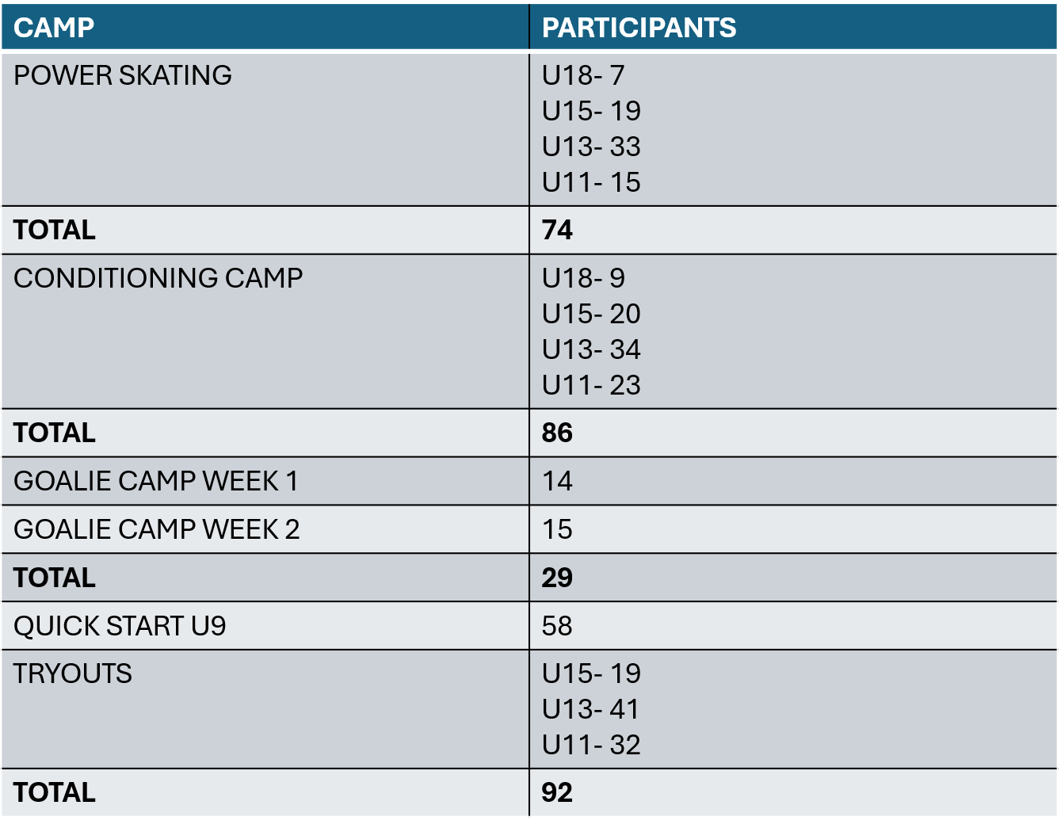
Registrar Report - camps
- Janet Boutilier

Slide 15
Registrar Report - volunteers
- Janet Boutilier
We had 89 bench staff
We had 14 team managers
We had 15 dressing room monitors
We had 28 members doing more than 1 role this year, such as coaching on more than 1 team, managing two teams, board members also filling roles as team managers, or safety rep’s

Slide 16
Goalie Coordinator
- Janet Boutilier
Goalie Camps were offered in the fall for two weeks
We offered a free goalie clinic once again to our members and on average would have 11 goalies per session to work on their skills and building important relationships with other goalies from U9 to U18

Slide 17
Ice Coordinator Report
- Ashley Halloran
The ESMHA had a successful season on the ice, with access to ice time seven days a week. Teams from U11 and up that requested additional practice sessions were accommodated. U9 teams that asked for extra ice were offered additional ice time when available.
Some teams expressed concerns about early morning practice times (6:00–7:00 AM); however, these slots were well attended by the teams that requested them and were rotated fairly among all teams in the extra ice rotation. The addition of 4:00 PM practice slots was new this season, and teams adapted well, recognizing that flexibility was required in order to secure additional ice time.
The U7 division consisted of two teams, each receiving two hours of ice time per week.
One of the main challenges this season was scheduling around other leagues hosting weekend home games. Many of our teams also had away games on weekends, which often conflicted with scheduled practice ice. In addition, weekday home games regularly occupied available weekday ice times, creating further scheduling difficulties. As a result, teams with fewer weekend game commitments generally had greater access to additional practice time.

Slide 18
Development Coordinator Report
- Becky Warner
The 2025–2026 season focused on continuing to grow player development opportunities across all age levels within ESMHA. This season included several successful initiatives, expanded programming, and continued support for coaches and players throughout the association.
Preseason Camps
Organized and delivered pre-season development camps prior to evaluations.
Introduced one new development components to the pre-season camps:
  Power skating sessions
Camps were successfully delivered over a two-week period and received positive feedback from participants and families.
Goalie Development
Weekly goalie clinics were offered throughout the season.
The clinics were a huge success and provided consistent goalie-specific development opportunities.
A sincere thank you to all instructors, volunteers, and coaches who contributed their time and expertise to make the program successful.
Junior Coach Program
25 junior coaches participated during the 2025–2026 season.
Junior coaches supported programming from U7 through U13 levels.
Their involvement provided valuable leadership experience while also supporting player development on the ice.

Slide 19
Development Coordinator Report, continued
- Becky Warner
Coach & Team Support
Additional support continued to be offered directly to team coaches throughout the season, including:
Goalie development support during team practices
Power skating instruction integrated into team practice times
Ongoing development assistance for coaches at the team level
Challenges & Areas for Growth
No ice allocation was available this season for Intro to Hockey programming.
Limited ice availability also impacted the ability to offer additional development clinics throughout the year.
Continued focus on securing development ice opportunities will remain important moving forward and supporting at the team level as ice time is sparse
Checking Clinic
ESMHA partnered with Trans4m Hockey to deliver the 2026 Checking Clinic.
18 players successfully completed certification through the program.
Thank you to all players, coaches, volunteers, families, and executive members who contributed to player development throughout the season. Continued collaboration and support are key to growing hockey development opportunities within ESMHA.

Slide 20
Coach Coordinator Report
- Whitney Halloran
We had another great evaluation process for our association this year.
We had great collaboration between the Coaching Coordinator and Development Coordinator to help ensure evaluations ran smoothly from planning through execution.
We benefited from a dedicated group of 11 independent evaluators, which helped provide consistency and fairness throughout the process. We also completed a second season using GrayJay, which continues to be an effective tool for managing evaluations.
Several enhancements were introduced this season, including a dedicated goalie-only session and having all on-ice practice sessions being led by a single instructor, providing a consistent evaluation experience across all groups. A goal moving forward with the evaluation process is to continue working to increase the number of goalie evaluators available in upcoming years.
We did require the use of Injury Player Protocol for one player at the U15 level.
We also continue to refine the U9 balancing process and are exploring additional structure for future seasons. Coach selection was completed successfully, and we continue to work with our registrar to improve our coach qualification attainment/verification process.

Slide 21
Equity, Diversity & Inclusion Coordinator Report
- Tanya Bezanson
As EDI Coordinator this season was my first year in this role and it was relatively quiet overall, with limited EDI-related matters arising throughout much of the year. Toward the end of the season, however, situations emerged that prompted important discussions within the association regarding how certain matters should be addressed moving forward.
As part of those discussions, a disciplinary committee was formed to help establish clearer processes, expectations, and accountability measures for handling future concerns or incidents that may arise. The development of this committee represents a positive step toward ensuring a fair, consistent, and transparent framework for all members of the association in future seasons.
Looking ahead, the goal for future seasons is to further develop the EDI role by providing members with more information, resources, and programs that support ongoing equity, diversity, and inclusion initiatives within the association.

Slide 22
Risk Manager Report
- Laura Rockwood
For the 2025 – 2026 Dressing Room attendants continue to be required.
All teams had a volunteer step up for this role. Thank you to the volunteers that took this on to help ensure we had a successful season.
​I am pleased to report that there were no player incidents reported this season

Slide 23
Representative & Recreational League Coordinator Report
- Hugues Mackay
Engagement across the various leagues has remained relatively low since the last update, with no notable developments, issues, or activities.
Ongoing discussion regarding potential league merger expansion. Based on the recent ESMHA family survey, support for any merger appears to be conditional rather than broadly enthusiastic. While some families are open to merger discussions in certain circumstances, there is no clear mandate for blanket endorsement.
The key concerns raised by families include increased travel burden, added costs, winter driving safety, scheduling impacts, and the effect on family and work commitments. Parents appear more comfortable with increased travel at older age levels, particularly U15 and U18, than at U11 or younger.
My view is that ESMHA should remain open to continued discussion, but only when proposals include clear guardrails, such as age-appropriate implementation, travel limits, regional scheduling considerations, affordability protections, and full disclosure of expectations prior to tryouts.

Slide 24
Equipment Coordinator Report
- Joel Stevens
Tim Hortons no longer sponsors jerseys for U9. ESMH purchased jerseys for this cohort to be used over two season. U9 conversion to club sweaters ongoing
U23 required purchase of XXX Large set of jerseys
Ongoing replacement of 25% of jerseys continues
Jersey fee of $50/player

Slide 25
U7 Coordinator
- Victoria Meldrum-Young
The U7 program had a fantastic season this year. We began the season with 90 registered players and finished the year with 89 players participating in our program.
Our registration breakdown included: 27 six year olds, 31 five year olds, and 32 four year olds.
Our players were divided into two groups: U7-1 (mainly 6 year olds) and U7-2 (mainly 4-5 year olds) Each group received two one-hour ice times per week throughout the season and held on Saturdays and Sundays for the majority of the season.
Christmas Party - This year’s Christmas Party was held at the Bingo Hall and included a bouncy castle, popcorn, games, and a small gift for every child. We were also lucky enough to have a special visit from Santa Clause, which was a highlight for many of the kids.
Year-End Party - Our Year-End Party was held once again at Cole Harbour Place. Players and families enjoyed one hour in the pool followed by one hour in the banquet room for food, awards, and year-end gifts.

Slide 26
U7 Coordinator, continued
- Victoria Meldrum-Young
Jamborees - Our U7 teams participated in four jamborees throughout the season including our jamboree. One of these jamborees was only open for the 5 and 6 year olds to attend.
  Eastern Shore Jamboree - Our Eastern Shore Jamboree was a huge success this season. Over two days in March, we hosted 61 teams, including 8 teams from our own association and 53 visiting teams from other associations. In total, approximately 680 children participated in the event. We also provided a fun zone in the Bingo Hall featuring: A Bouncy Castle, Target Shooting, Popcorn, Cotton Candy, Face Painting and a Sucker Pull. In addition, we offered a hospitality room with hot chocolate, coffee, Timbits, water, and snacks for families, coaches, and volunteers.
Mooseheads Opportunities - Our 6-year-old players once again had the opportunity to participate in the Mooseheads intermission games. We were provided with three games this season, and all interested players were able to participate. For each game, one player was selected by random draw to join the Mooseheads on the ice during the National Anthem. We also attended a Mooseheads Minor Hockey Night in January, where families enjoyed the game at a discount together in a designated section and all players received a Mooseheads toque.
Development - This season, we were fortunate to have Troy from Outside Edge Hockey Development attend several practices for both groups. Troy worked alongside our coaches to run power skating sessions focused on skating fundamentals, balance, edge work, and gliding skills.

Slide 27
U9 Coordinator
- Vacant (Acting Laura Rockwood & Janet Boutilier)
The U9 Coordinator position was vacant
The association hosted three U9 teams, one each at the Development, Intermediate, and Advanced levels.

Slide 28
U11 Coordinator
-Laura Rockwood
ESMHA U11 – 2025 – 2026 Season
We had 47 children registered for the 2025– 2026 Season. We were able to ice One A team & Two C teams.
29 children participated in pre-season camps.
The U11 division enjoyed a fantastic season. Although we lost one player in December due to an out-of-province move, we were thrilled to welcome two new players—including one who recently relocated from West Hants. Both joined the U11 C teams and proved to be wonderful additions.
​The U11 C Gold team had a busy and successful year, participating in two away tournaments and two local ones, including our own house tournament where the kids took home the bronze medal. The hard work of the players and coaches truly paid off, as the team captured two banners this season: one for the playoffs and another for the Day of Champions!
​I cannot say enough good things about our coaching staff. They did an incredible job this year, striking the perfect balance between fun and hard work, both on and off the ice. On behalf of the entire U11 division, a sincere thank you to all the volunteers who make our hockey seasons possible.

Slide 29
U13 Coordinator
- Gillian Florence
The 2025–2026 season saw strong participation at the U13 level, with 53 players registered across U13AA, U13B, and U13C programs.
A major highlight this season was the successful return of a U13AA team, marking the first time in several years that Eastern Shore was able to field a team at the AA level. This was an important step forward for the association and provided players with an opportunity to compete at a higher level within a provincial league structure
U13C
Finished 10th in league standings with a 1-27-1 record.
The team faced a challenging season against experienced competition.
Coaches, players, and families continued to show commitment and perseverance throughout the year.
U13B
Finished 12th in league standings with a 3-21-2 record.
The season presented challenges competitively within a strong division.
Despite difficult standings, players continued to compete throughout the season and represented the association positively.

Slide 30
U13 Coordinator, continued
- Gillian Florence
U13AA
Finished 7th in the regular season standings with an 11-13-2 record.
Competed in a provincial league, which required significant travel and scheduling commitment from players and families.
Participated in three tournaments and advanced to the Sunday playoff round in all three events.
The season was viewed as a strong success for the program and an important building block for continued development of high-level hockey on the Eastern Shore.
Feedback from the U13AA team emphasized the commitment and adaptability shown by players, coaches, and families throughout a demanding season schedule.
While the standings at the B and C levels reflect a difficult season from a win-loss perspective, they do not fully capture player growth, effort, commitment, team culture, or development throughout the year. Those areas are best reflected by the experiences of the players, coaches, and team staff directly involved with each team.
Overall, the season highlighted both the opportunities and challenges that come with sustaining multiple competitive levels within a growing association. Fielding a successful AA program while continuing to support participation across B and C divisions remains an important part of player development on the Eastern Shore.
Thank you to all players, coaches, managers, volunteers, and families for their time, dedication, and support throughout the 2025–2026 season.

Slide 31
U15 Coordinator
- Chelsea Burgess
U15C
U15C had a full and well-rounded team this season, including one player who was new to hockey and another player who was new to our team. We carried a full roster of 19 players, made up of 17 skaters and 2 goalies. Having two goalies helped reduce the pressure on any one individual goalie and allowed families greater flexibility in managing travel challenges and other team commitments.
The team experienced many successes throughout the season, including earning 3rd place in playoffs. We were also fortunate to have an outstanding coaching staff that fostered strong developmental growth while consistently promoting a positive and respectful attitude toward players, opposing teams, and officials.
The biggest challenge we faced this season was related to dressing room supervision. Supervision at this level continues to be difficult, particularly when teams are led by non-parent coaches.

Slide 32
U15 Coordinator
- Chelsea Burgess
U15A
The U15A team had a positive and successful season overall. The group remained competitive throughout the year and finished in the middle of the standings with a respectable record of wins and losses. Most importantly, the season was marked by strong teamwork, sportsmanship, and a positive atmosphere among both players and families.
The team participated in several tournaments over the course of the season, gaining valuable experience and opportunities for development. While we did not come away with any tournament titles or banners this year, the players continued to show growth, resilience, and commitment throughout the season.
There were no significant issues involving players or families, which helped contribute to a smooth and enjoyable year for the coaching staff and team management.

Slide 33
U18 Coordinator (no team)
- Tanya Bezanson
As U18 Coordinator, the 2025–2026 season began with significant uncertainty regarding whether there would be enough players to ice a U18 team at all. Through considerable recruiting efforts and ongoing work throughout the offseason and early part of the year, sufficient player numbers were eventually reached to move forward.
Unfortunately, despite those efforts, the association was unable to secure a goalie prior to the start of the season, which ultimately resulted in the team folding. Efforts were then focused on ensuring players still had opportunities to continue playing hockey by facilitating releases to programs in Cole Harbour, Dartmouth, as well as U23 programs for eligible players.
One of the most difficult outcomes of the season was seeing some players choose not to play hockey at all. Maintaining opportunities for athletes to stay involved in the game remains an important priority for the association and its volunteers.
Looking ahead, the hope is that player numbers will be strong enough next season to successfully ice a U18 team and potentially welcome some of those players back to Eastern Shore Minor Hockey.

Slide 34
U23 Coordinator
- Adam Jennex
This was the first season for a U23 Team at ESMH
This age group struggled with late game times and attendance but managed to have a lot of fun and some success during the season.
A U23 team for the 2026-20276 season will be investigated and a decision on hosting that team will be made in September.

Slide 35
Questions & Answers

Slide 36
Conclude 2025-2026 season

Slide 37
ELECTION OF EXECUTIVE
2026-2027 SEASON
President – DUE FOR ELECTION (Vacant – 2-year term)
Registrar – DUE FOR ELECTION Janet Boutilier – incumbent – reoffering
Budget Coordinator – DUE FOR ELECTION
Development Coordinator – DUE FOR ELECTION
Equipment Coordinator – DUE FOR ELECTION
Secretary – DUE FOR ELECTION Julie Wagner – incumbent – reoffering
Risk Manager – DUE FOR ELECTION
  Laura Rockwood – incumbent – reoffering

