Slide 1

ESMHA Annual General Meeting
June 11, 2023

Slide 2
Agenda
Introductions & Call to Order;
Approval of Minutes from 2022 AGM;
Reports:
  President;
  Divisional Coordinators:
    U7;
    U9;
    U11;
    U13;
    U15;
    U18;
Reports Continued:
  Equipment Coordinator;
  Development Coordinator;
  Treasurer;
Q&A;
Elections:
  Vice President;
  Treasurer;
  Ice Coordinator;
  Female Coordinator¹;
  Recreation Coordinator;
  Coaching Coordinator;
  U7 (IP) Coordinator;
  U9 (Novice) Coordinator;
  U11 (Atom) Coordinator;
  U13 (Peewee) Coordinator;
  U15 (Bantam) Coordinator;
  U18 (Midget) Coordinator
  ¹Bylaw proposed to change to Equality, Diversity and Inclusion Coordinator
Bylaw Changes VOTE
Adjournment

Slide 3
Introductions & Call to Order
Welcome

Slide 4
Approval of Minutes from 2022 AGM
Date: June 12th, 2022
ESMHA 2021 AGM Meeting Minutes:
ESMHA 2021 AGM Reports and Financials:
NEED LINKS

Slide 5
Reports: President
President: Paul Anderson
2022/23 ESMHA AGM President Report
I can't think of any other way then to start the 2022/23 Presidents report by Congratulating our Mariners hockey family on an amazing season, it was one for the record books. Ten Championship Banners from five different teams from U11B, U11A, U13B, U15C, and U15A. The U13AAA Mariners had a strong playoffs and represented our region at the provincials in Antigonish. The U15A Mariners had an impressive season. This 2008/09 group has working toward this outcome sense they started in Timbits together. 19-1-4 regular season record, 8-0-3 in playoffs, 5-0-0 in provincial play downs. Five different championship game appearances taking home the CMHL title, South Conference title in Yarmouth against Yarmouth, and the Provincial Championship in Truro against a strong Brookfield team. Congratulations to the U15A Mariners, we are extremely proud of you all!
The highlight this season for me personally was not the wins or banners. It was the adversity that our teams faced from the beginning of the season and how these teams handled and faced the various challenges head on. Having teams forced to dissolve and merged together at U13 and U15 was not an easy transition. Instead of walking away or complaining our young players lead the way and set an example we can all be proud of. They understood it was out of their hands and what they needed to do was play hockey and be the best teammate they could be.
I love being in the rink, talking hockey and hearing stories from folks that have been a part of our community for many years but most all I love seeing the raw emotion and joy on the ice. This game has so much to offer and watching our U11C team grow and learn together was the true spirit of team sport. This team supported each other in the tough moments and celebrated together with each and every individual and common win. We can all learn from these amazing kids, and I thank them for lettings us be apart of there hockey journey.
…Continued…

Slide 6
Reports: President (Continued)
President: Paul Anderson
2022/23 ESMHA AGM President Report
Congratulations to our U7 and U9 players, families, and Coaches on a great season. It was awesome to have a full season of tournaments, Jamborees, and games. We are excited to see the growth and development of youngest Mariners. Thank You to the organizers, families, and volunteers for continuing our legendary ESMHA Timbit Jamboree and 25th ESMHA Invitational Tournament. We look forward to these events each year and they just keep getting better each season. The positive feedback i have received from outside of our association is spectacular.
I am truly proud of the all accomplishments of our volunteer committees and teams this past season. We have had some big goals that were impeded on due to the pandemic but with determination and passion we were able to see them though to success. Thank you to our wonderful Finance committee, Leadership and growth committee and U13AAA committee. Your time and dedication is inspiring and appreciated
This season did not come with out its fair share of challenges and learning curves. Our executive team has and will continue to keep open dialogue and discussion for continuous improvement where and when it is needed. Our most import goal has and will continue to focus on the safest and best possible experience for everyone.
I look forward to next season and celebrating with our hockey families 50 years of minor hockey on the shore. #PROUDTOBEAMARINER #BeBradyBrave
Kindest Regards,
Paul Anderson

Slide 7
Reports: U7
U7 Coordinator: Danielle Vokey
2022/23 ESMHA AGM U7 Coordinator Report
Season Recap/Changes:
68 players registered (birth years 2016, 2017, 2018)
20 rostered Coaches with help from U9 & Intro to Hockey Program coaches
Team Managers for each U4, U5, U6(x2) Teams
Parent & Coaching meetings held prior to season start
11 Junior Coaches (5-6 per ice time when available)
4 – 1hr ice times per week, 2 ice times per player (33-35 players on each ice time, preference would be maximum 30 players)
Players were tiered by like-abilities. Followed HNS policy. Created better development & more confidence within players.
Communication through Teamlinkt App for parents & coaches. Schedule for ice & off ice activities/events were posted, forms, documents explaining events such as picture day, etc.
Coaches received detailed lessons plans with diagram on their own Teamlinkt app page prior to practice.
New equipment was purchased at season start. Pucks, hockey balls, sponges, pylons, dry-land agility kit, etc. Equipment was kept in lockers where coaches had access and shared within association with Intro to Hockey, etc.
1 hour, monthly dry-land training offered to all U7s (no extra cost) in Bingo Hall ran by parent volunteers. (Thank you to Ashley Bellefontaine from PhysioLink Porter’s Lake for October & November’s training). Great player turnouts each session.
Power Skating extra ice program offered in Feb/March to those interested, ran by parent coaches, and cost was price of ice time. 26 players registered
…Continued…

Slide 8
Reports: U7 (Continued)
U7 Coordinator: Danielle Vokey
2022/23 ESMHA AGM U7 Coordinator Report
Highlights of the Season:
Moosehead Intermission Games offered to all 2016s. Had 4 opportunities
Flag bearers for opening of Eastern Shore Thunder home games
Musquodoboit Harbour Christmas parade float
U7 Christmas party with bouncy castles and a surprise appearance & gift from Santa
Mariner’s Month Showcase at Eastern Shore Thunder Game, U4 opening flag bearers, U5-U6 played intermission games against each other
Phil Sears Friendship Tournament in Brookfield over Christmas Break. 3 Teams were entered from U5/U6
Minor Hockey Day with the Mooseheads, 49 players & families attended Moosehead’s game together
Joanne Lenihan Jamboree in Bedford, 45 players - 4 teams participated
2022-23 U7 Eastern Shore Jamboree! Two full day success of 44 Teams & all smiling faces
Year End party at Cole Harbour Place with pool, pizza and year end gifts
…Continued…

Slide 9
Reports: U7 (Continued)
U7 Coordinator: Danielle Vokey
2022/23 ESMHA AGM U7 Coordinator Report
Recognizing U7 Challenges & Proposed Resolutions:
Challenge: Registration. Too many players registered late which caused issues with appropriate ice time, adequate number of coaches and equipment/jerseys. Missing the parent meeting, etc.
Resolution(s):
Early bird registration discount for first time players or even all players
more advertising throughout community via social media with clear information on refund policies, payment plans and equipment requirements.
Include Medical forms and jersey size by child’s clothing size (example size 4T-7) in online registration form.
Challenge: Coaching. Appropriate amount, experience and being certified by December 1st.
Resolution(s):
Propose change to the U7 coaching policy to be 3:1 ratio for each player, and unlimited “support coaches” for those players who require one on one.
Coaching clinic with Coaching Coordinator/Development Coordinator, U7 Head Coach, U7 Coordinator on and off ice, complete prior to regular season start or within first couple weeks. Provide coaching techniques for ages 4-6, step through coaching courses required, setting up accounts, setting timelines etc. Strong foundations at U7 level are key for development.
Thank you to the community and urban HRM for their generosity for the Jamboree prizes and donations. I want to acknowledge and thank the volunteers, mostly parents but also the high school leadership team and junior coaches, who came forward to make this season such a success. The players received the best gift this season witnessing how a small community can come together to achieve great things.
U7 Eastern Shore Minor Hockey Association had an amazing 2022-23 season with great communication, development and most importantly, so much fun. Go Mariners!

Slide 10
Reports: U9
U9 Coordinator: Laura Rockwood
2022/23 ESMHA AGM U9 Coordinator Report
Our U9 level had a great season. We had 50 players registered this year. Allowing us to have a Development, Intermediate and Advancing team.
All teams were able participate in tournaments and full ice games.
We saw development in all players from all teams.
Mariners month was a great success and the kids enjoyed cheering on other teams and seeing teams come to cheer them on.
The biggest issue we had to overcome was getting parents to volunteer.
Families would like to see the canteen open more and on a set schedule.

Slide 11
Reports: U11
U11 Coordinator: Chelsea Burgess
2022/23 ESMHA AGM U11 Coordinator Report
U11C- had a few hiccups at the beginning of the year(we lost a few coaches and goalie) but we ended the season with a few tournament wins and tremendous growth. We added 4 players mid season which brought it up to 17 players + goalie. We had 10 female players! Regular season wins were 1, regular season losses were 25. The team really enjoyed the 25th annual home tournament.
U11B- No comments.
U11A- 14 players, very strong season with a winning streak of games, attended 3 tournaments. Games were well attended, and atmosphere pumped up kids. Nonparent coach was an amazing experience for the team and parents.
Made it all the way to final game for playoffs and brought home the regular Season banner

Slide 12
Reports: U13
U13 Coordinator: Jodi Bengert
U13C
Challenging, slow start to the season when two small teams merged into one large one. With this merge came difficulties with the heavy coaching staff and their undefined roles. While the merge was hard, and had a few bumps to smooth out, the large team was amazing and many players and families felt this way. A suggestion for the new season - large teams should not be assigned half ice, especially at the U13 level. This happened a few times for our team and most of the players took a knee for the bull of the practice.
U13B
We had a great season! We attended 2 away tournaments where we took Gold at both the Bobby Joe and Gary Wentzell. We also attended SEDMHA and were the Accord level champions! All of our players showed great progress in their ability throughout the season. Most importantly the team all had fun.
U13AAA
The team came 8th out of 16 teams. They did three tournaments - the Jordan Boyd, the Edd McNeill and the Spud. During the Edd McNeill there was a skills competition where the team finished 2nd place out of 16 teams! The team played Sackville in the playoffs, beating them in two games and headed to provincials in Antigonish. Coaching staff was great - Jonah Leroux, Tyler Symonds, Dan Flemming and Craig Hillier worked hard with the players every practice. The players overall had a great season.
2022/23 ESMHA AGM U13 Report

Slide 13
Reports: U15
U15 Coordinator: Jodi Bengert
2022/23 ESMHA AGM U15 Report
U15C - Because of the hard work the coaching staff, parents and players put in, we all became a team (on and off the ice) and ended up winning it all and became city champs! The team won in overtime to make it to the City Championship game. It was the most incredible game for all of us! You could tell they finally were a team and they wanted it so bad! Day of Champions game was such a great experience for everyone!! The kids were so excited and when they won the place went crazy. A few other things we did was go to Truro to play exhibition games, the Joe and the ES house tournament. We also did our year end party at axe throwing which was so fun for all! Overall the kids made so many great life long memories and that is what it is all about!
U15A - What a year! It was definitely a very exciting one for the U15A boys. Every practice they showed up and pushed themselves to become better each week. In the end, they had amazing success winning regular season, central minor and provincials. This was a very big accomplishment for the team.
With an early Nov tournament in Sydney CB we saw what the boys could do. We came up short in the gold medal game but it gave the boys time to hang out and bond. Back at home we were playing hard and having great success. After a nice break over Christmas we came out strong in Jan. Looking back at the season, the team hadn’t lost a game since November in regular season. With our second tournament in Moncton came a lot of fun! Not only did we play hockey but the team got to skate under the lights and take in a Wildcats game! We came up short again in the gold medal game. It was a hard loss but I believe it gave them the drive to come back home and play harder. Winning regular season and central minor we were off to play Yarmouth. The game was to be played on the same weekend as our 3rd tournament. The boys had a hard decision but ultimately deciding to pull out of the tournament and go to Yarmouth and WIN! Next was the Day of Champions in Truro. The team was faced to play the team we had lost to in every gold medal game in tournaments. For some of the boys it had been a 2 year running loss against the Elks. But they came to play winning Provincials!!! To see their faces and the coaches when the buzzer rang… it made this year all worth it. I think everyone was crying at this point!
To end the year on a high note - at the last minute I decided to pull together an end of year banquet at the sailing club. The team worked hard and they deserved to be celebrated! Also some of these boys have been together since IP and this will be the last year they will all be together! It went off with great success and lots of memories were celebrated!

Slide 14
Reports: U18
U18 Coordinator: Shannon Karsten
2022/23 ESMHA AGM U18 Report
15 players on the U18C team this season.
The U18 C team had a great season, finishing third out of nine teams in the regular season, and fifth in the playoffs.
Thanks to our coaches, Fred Werner, Don Crouse, John Timmons, Danny Faulkner and Tyler Avery. They committed and supported our players and shared their love of hockey. Their dedication to the team has been instrumental in the team’s positive season.

Slide 15
Reports: Equipment Coordinator
Equipment Coordinator: Joel Stevens
Equipment Coordinator Report 2022/23
As my first year as ESMHA equipment manager, everything seemed to go quite well. We made great progress on our equipment room before the season started. But I soon figured out that we are lacking in space. Hopefully we can address this situation going forward.
We purchased one new set of jerseys for the U11B team that was formed this season.
We also purchased some replacement jerseys for sets that were either missing or jerseys that just were not up to par.
We also purchased 2 brand new sets of goalie pads for our U9 goalies and a set of used goalie gear for anyone wanting to try at a higher age level.
Something new this year and purchased 2 tryout jerseys for every player registered in the tryout process. I personally thought this was a great idea and worked quite well. With a few adjustments I think this can be even better.
Staying with the tryout jerseys. I have a request for quotes from local company in Lawrencetown to supply them for the upcoming 23/24 season. I have also requested that they have the stop sign printed on the back for exhibition game purposes.
The association had also agreed to work with Craig and Michelle Brown from Soles skate sharpening this past season, to help dress all our Mariners in ESMHA swag. I believe this has been a great move for the association and its members.
The only real issue I have had with the year was jersey cheques. They just did not work. I felt that the managers were having a really hard time collecting them, as no one has cheques anymore. That meant I had long delays receiving them, that’s if I received them at all. I would really like to look at better options in the future.

Slide 16
Reports: Development Coordinator
Development Coordinator: Becky Warner
Development Coordinator Report 2022/23
ESMHA offered the following events in terms of development this season:
conditioning camps
intro to hockey program (first annual), 40 players. Great success. Able to obtain a grant from HNS $5000 to offer this 10 week program next season
junior coaches program was successful in its second year (27 coaches; 13-18 years of age)
junior thunder skills program offered (u7/u9) 4 week program in support of junior c thunder.
goalie coaches clinic with Todd bengert- offered off ice and on ice session to coaches re goalie specific coaching
female mariners day ( 30 female players/coaches) came out to celebrate our female membership with an one hour ice time
u9 transition to u11 - 1 day camp to go over rules and transitions to full ice for 2nd year u9’s
checking clinic
Power skating was offered but not enough registrations to go ahead.
Association received development association of the year award from HNS

Slide 17
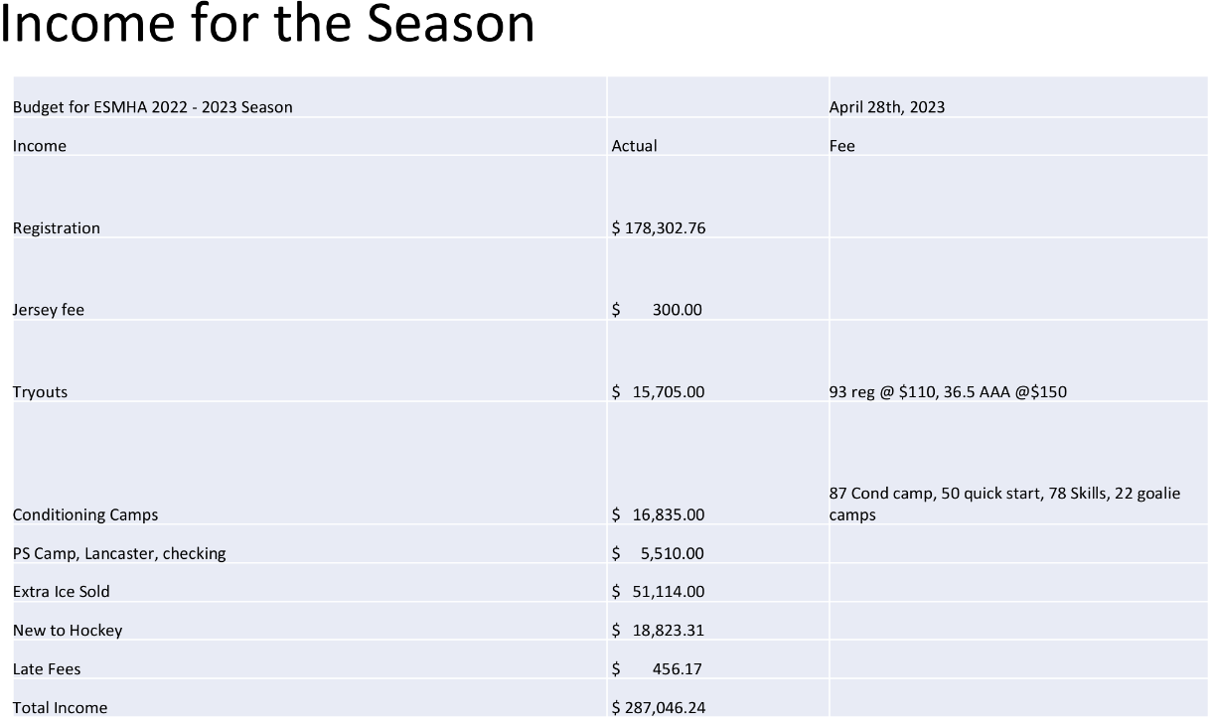
Treasurer: Natalie Stevens
2022/23 ESMHA AGM Treasurer Report

Slide 18
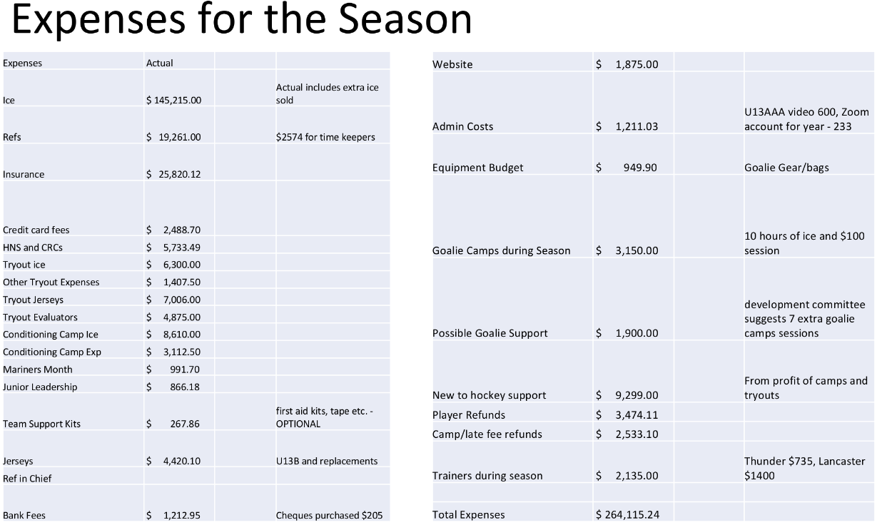
Treasurer: Natalie Stevens
2022/23 ESMHA AGM Treasurer Report

Slide 19
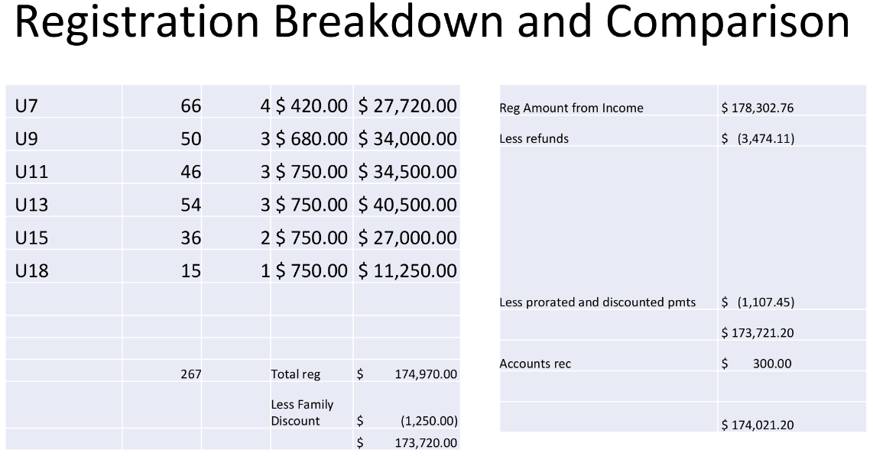
Treasurer: Natalie Stevens
2022/23 ESMHA AGM Treasurer Report

Slide 20
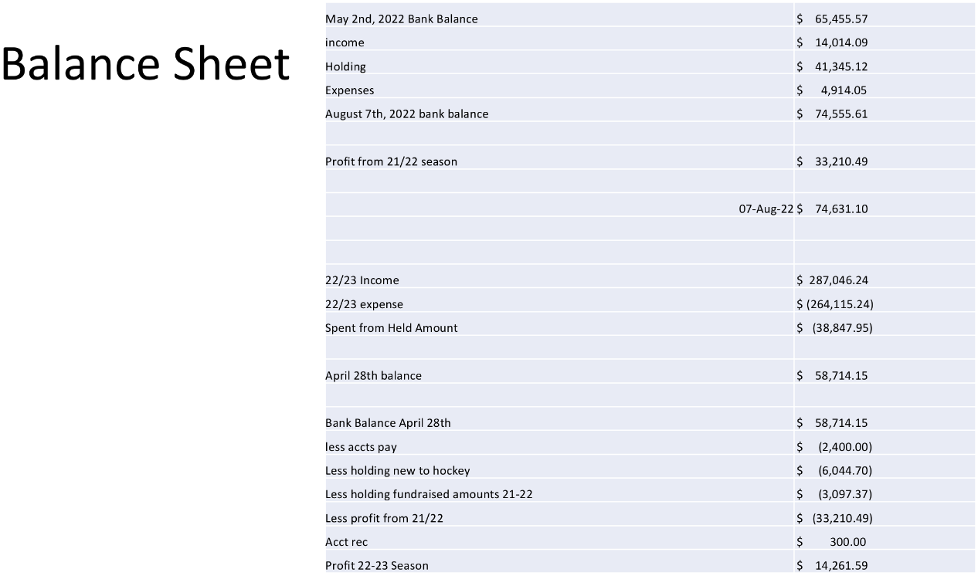
Treasurer: Natalie Stevens
2022/23 ESMHA AGM Treasurer Report

Slide 21
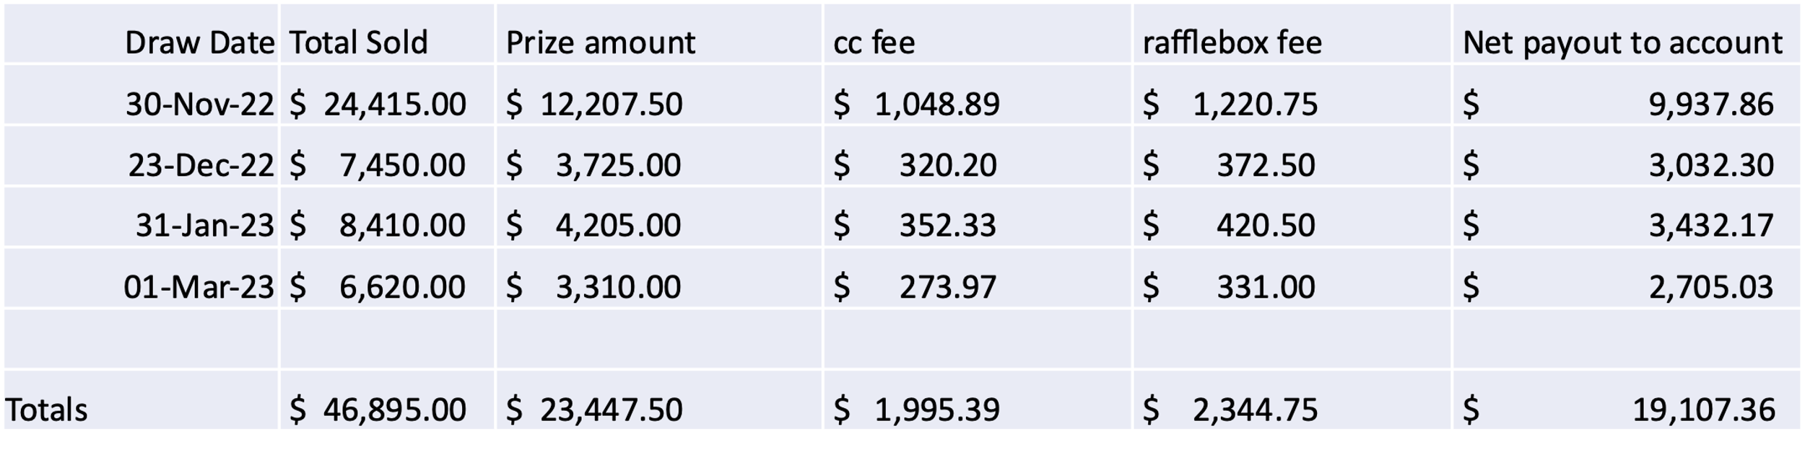
50/50 Season Financials
Net Payout to Account | $ 19,107.36
Lotto fee (2.13% *prize amount) | $ (499.43)
Bank Fees for season | $ (161.50) | **$100 added to keep account going
Amount for New to Hockey | $ (106.63) | **Overage from amount remaining of 38% profit
Used for fundraising | $ (3,140.72)
Remaining credits for next season | $ (14,989.08)

Slide 22
Q&A
Questions!

Slide 23
Elections
Position | Nominee
Vice President | Adam Jennex
Treasurer | Natalie Stevens (Incumbent)
Ice Coordinator
Female Coordinator¹
Recreation Coordinator | Rod Thurber (Incumbent)
Coaching Coordinator
¹Bylaw proposed to change to Equality, Diversity and Inclusion Coordinator
Position | Nominee
U7 (IP) Coordinator | Danielle Vokey (Incumbent)
U9 (Novice) Coordinator | Laura Rockwood (Incumbent)
U11 (Atom) Coordinator | Chelsea Burgess (Incumbent)
U13 (Peewee) Coordinator
U15 (Bantam) Coordinator | Jodi Bengert (Incumbent)
U18 (Midget) Coordinator

Slide 24
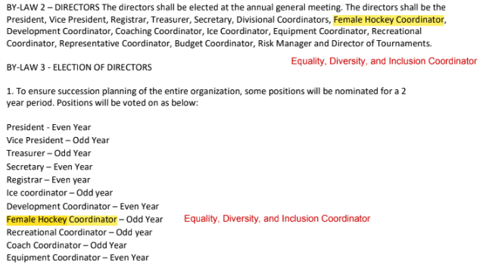
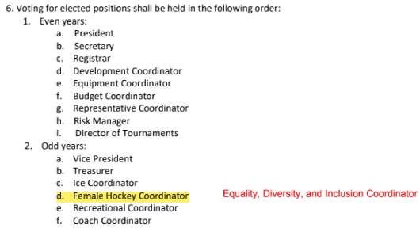
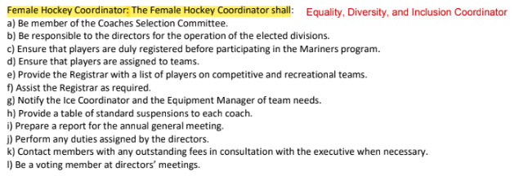
Proposed Bylaw Changes - Vote

Slide 25
Adjournment
Thank you all!

